Slide 1
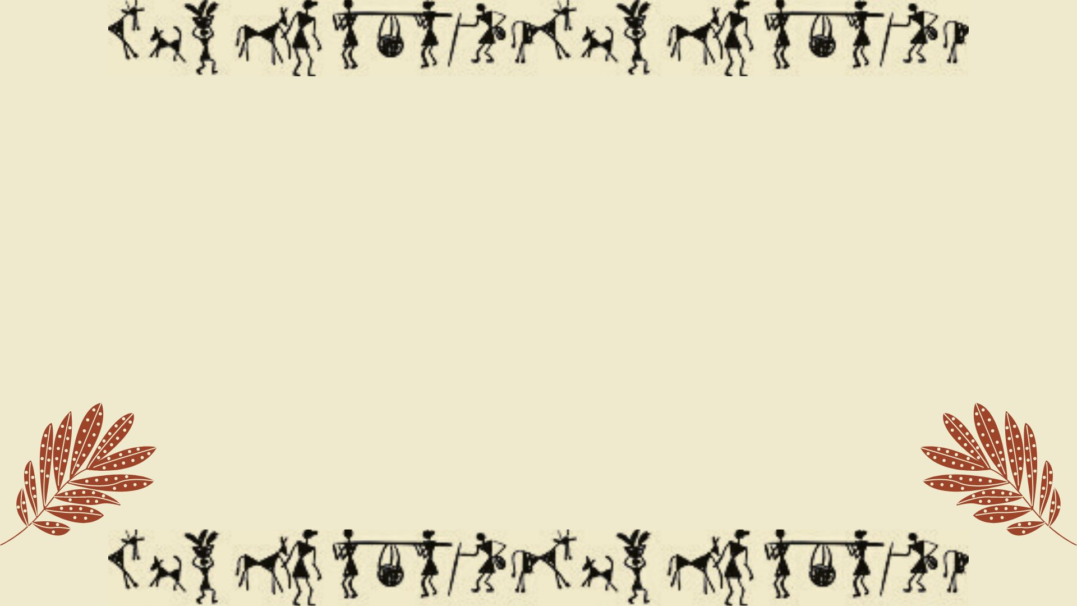
VIBRANCE ART AND CULTURE
-ONE STOP SOLUTION FOR ART LOVERS
TEAM BACKSLASHN
TEAM MEMBERS:-
KARTIK SHARMA
SHUBHAM SAIN
TANISHQ SHARMA
Contact Details:-
9412229666
sharma.kartik22a@gmail.com

Slide 2

CONTENT:-
ABOUT WARLI ART
BUSINESS MODEL
CANVAS
MARKETING AND PRICING STARTEGY
COLLABORATIONS

Slide 3
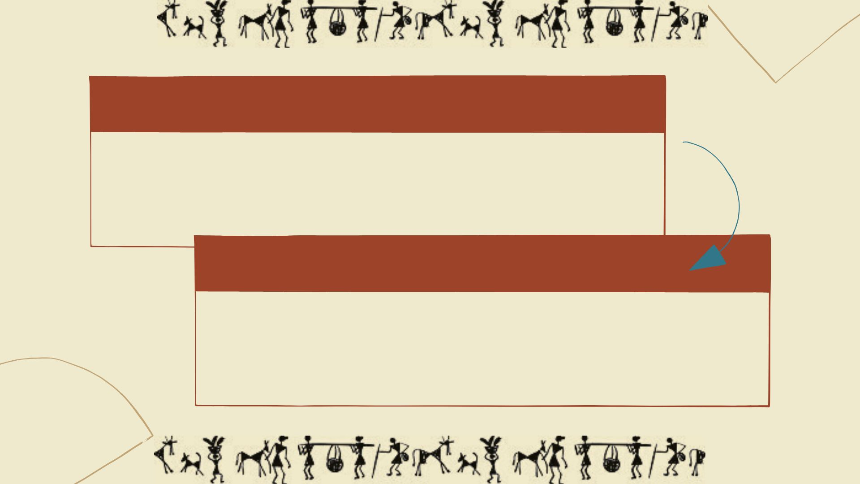
WARLI ART
Every tribal artform has its own significance and tells a story about culture, community , history which depicts the social life of the tribal culture.
Warli painting is a form of tribal art created mainly by the tribal people from the North Sahyadri Range in Maharashtra, India. This tribal art originated in Maharashtra, where it is still practiced today but at a rapidly declining rate.
AIM
Our aim is to promote the traditional Folk art of Warli paintings and uplift the tribal community of India.

Slide 4
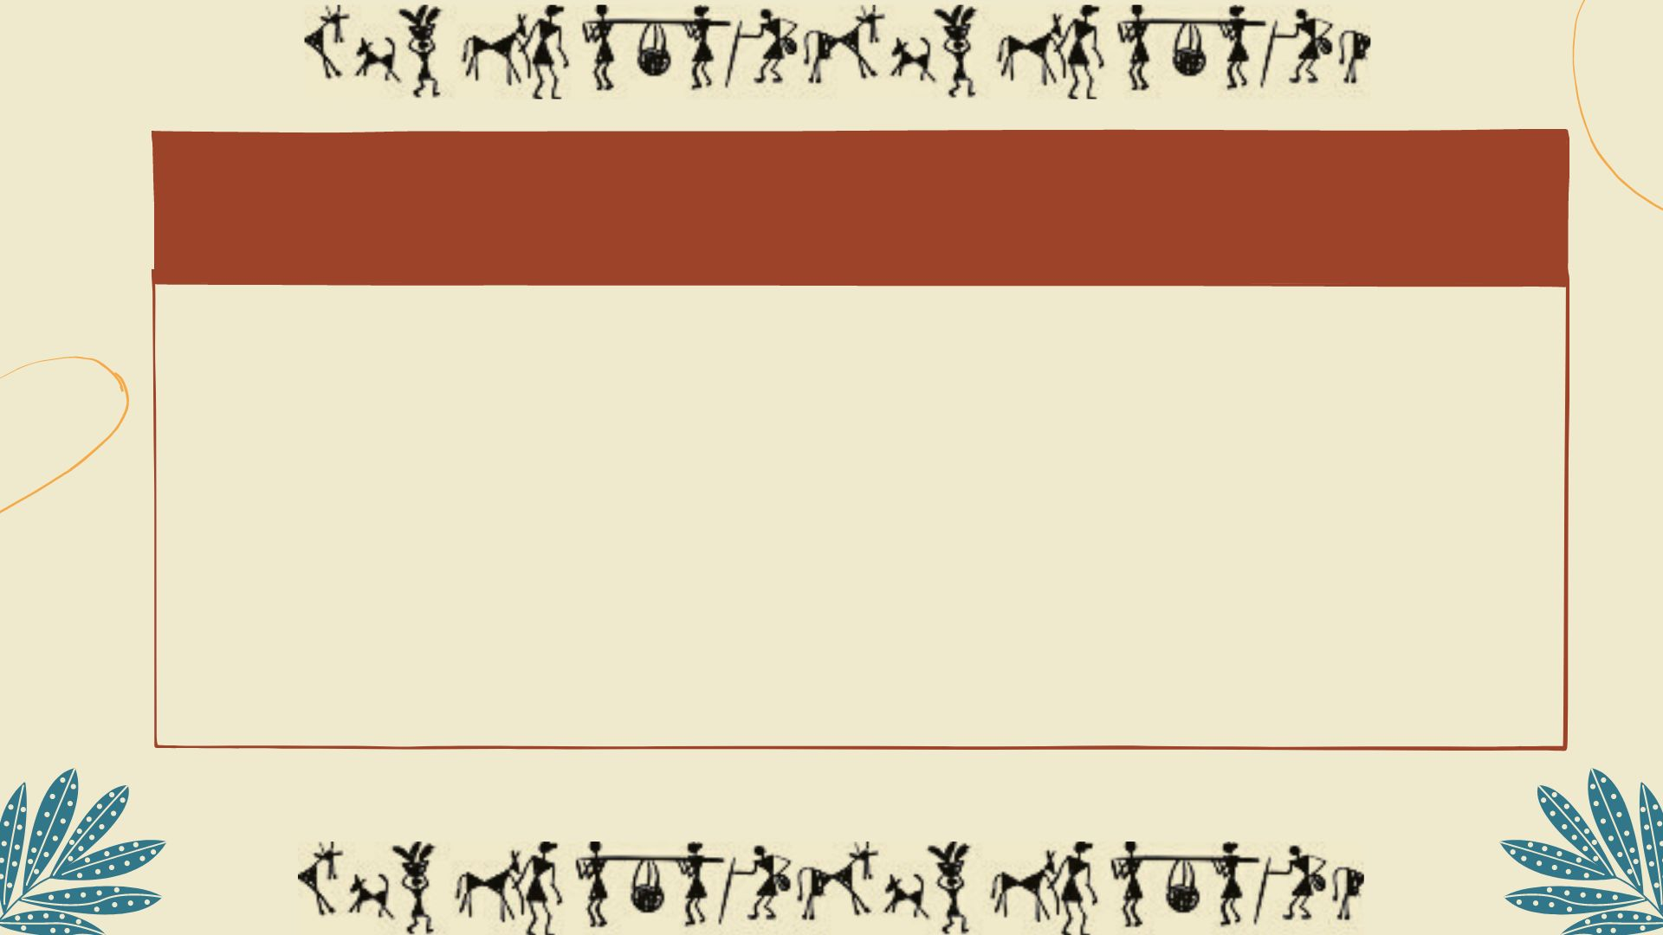

BUSINESS MODEL
Our first Revenue Stream is -> Selling warli art paintings and printed items like clothing , cutlery , decorative pieces through business website(www.vibranceart.com)
Second Revenue Stream -> We will be putting up stalls in exhibitions like invest summit, literature festival.
Third Revenue Stream -> Partnering with local guides for village visit and selling products directly to tourist.
Village Visit
Business Website
Exhibitions

Slide 5
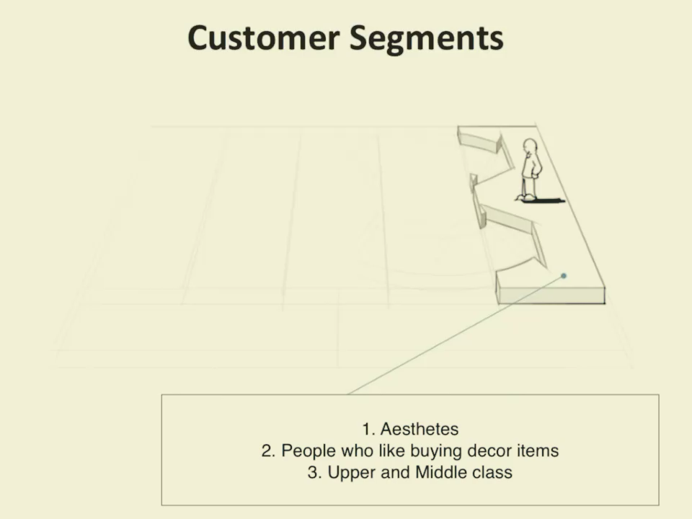
VIDEO REPRESENTATION OF BUSINESS CANVAS MODEL

Slide 6
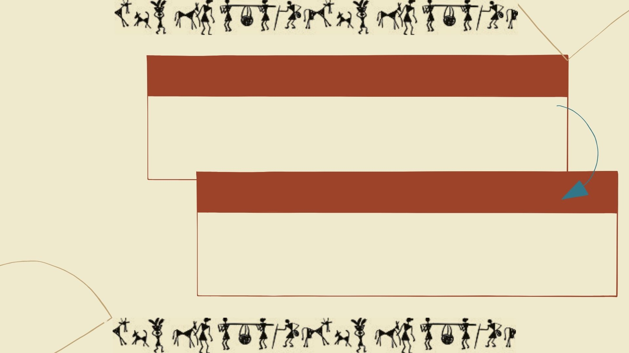
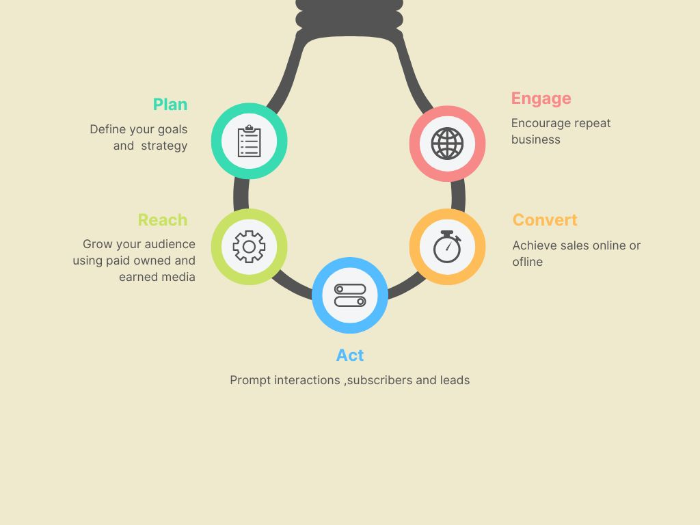
MARKETING STRATEGY
Our main marketing strategy will be social media marketing
Painting on street walls with branding of the company. Hoardings across cities.
We will do affiliate marketing.
Building a RACE FRAMEWORK which allows managers and marketers to optimize their key interaction.
PRICING STARTEGY
We will be maintaining rates according to the actual worth of product.
Charm pricing strategy.
We will participate online biding program for our exclusive products.
We will have Competitive pricing strategy with our competitors.

Slide 7
COLLABORATIONS
Collaborations with local government bodies , social media influencers, local sellers, local guides. We will also collaborate with NGOs who will purchase our paintings and spread awareness about warli artforms.
WHAT MAKES OUR MODEL UNIQUE?
Three stream revenue model
For increasing sales partnering with local tourist guides
Marketing strategy (Race Framework)
Pricing strategy(Charm Pricing)

Slide 8
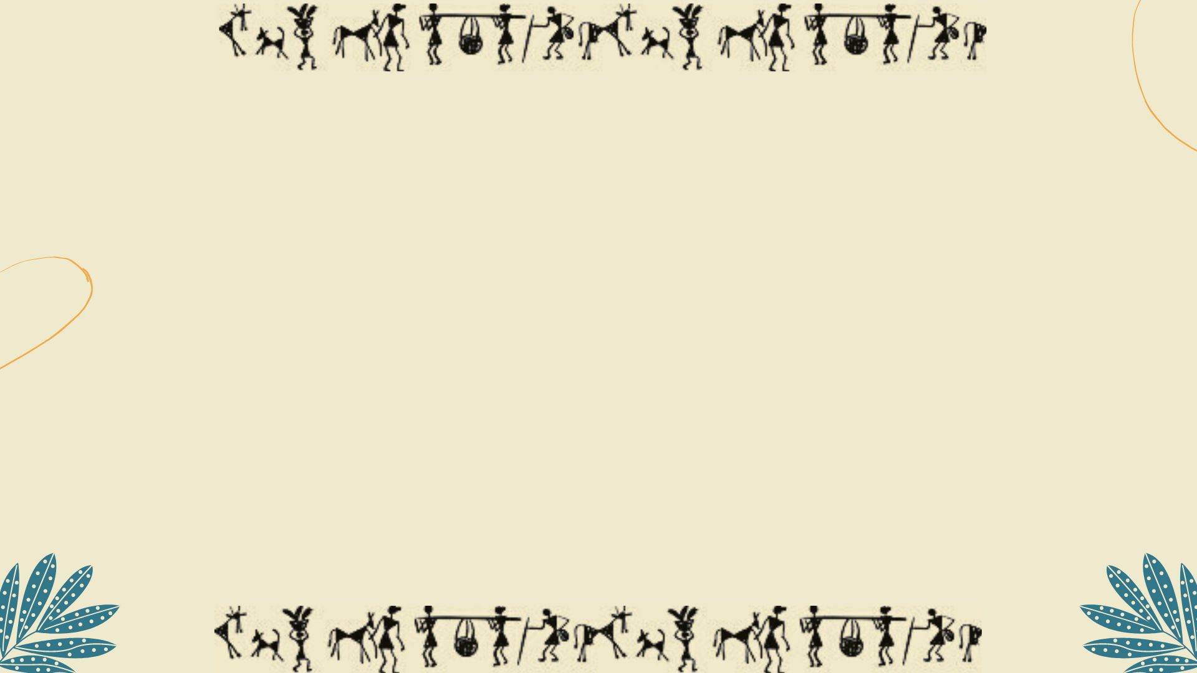
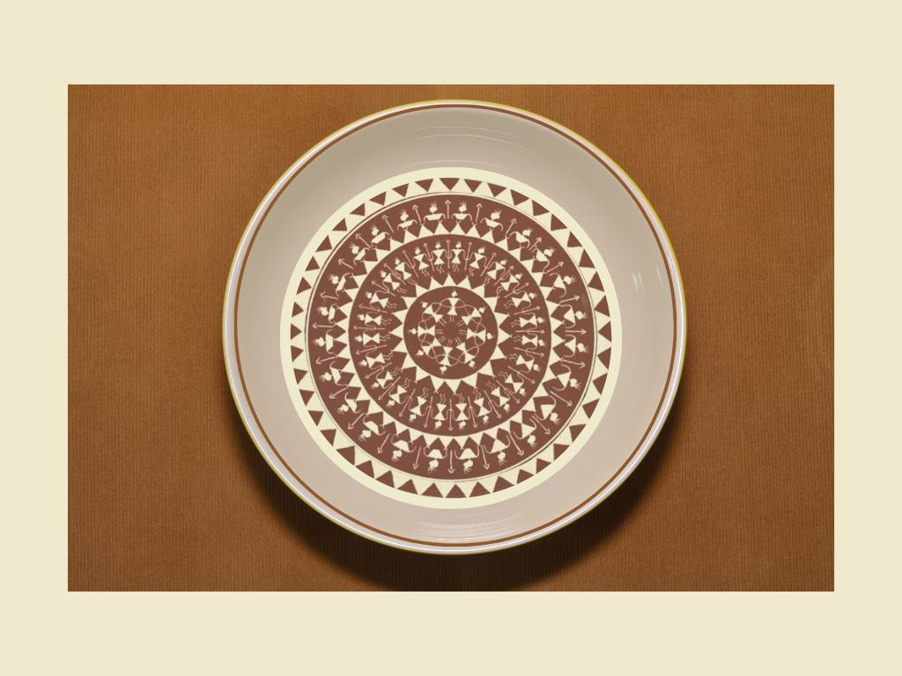
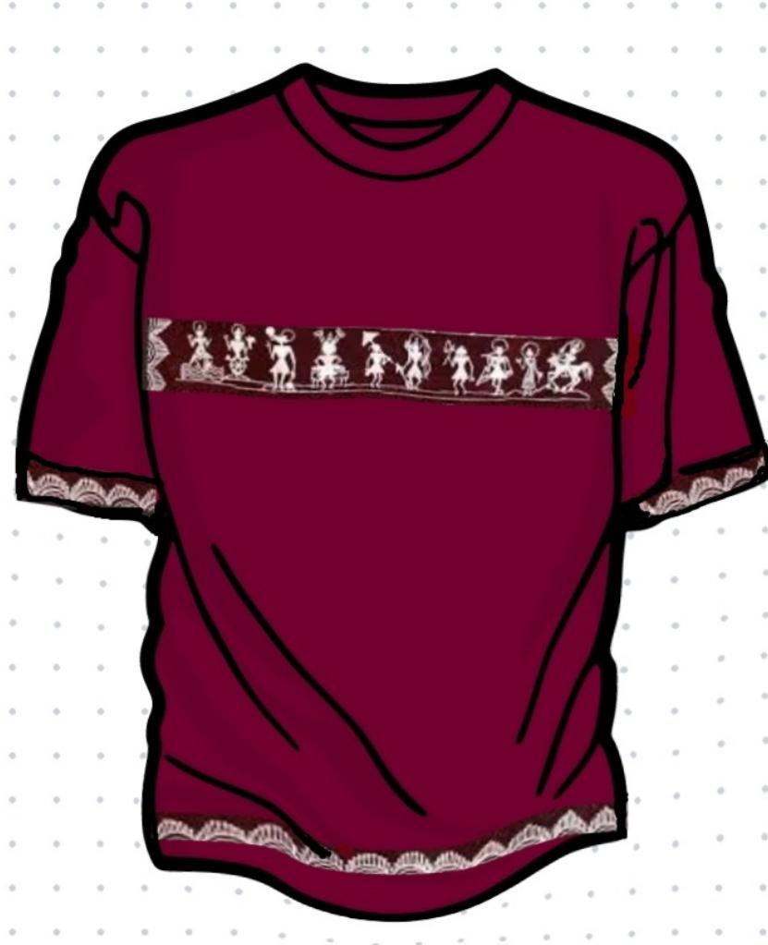
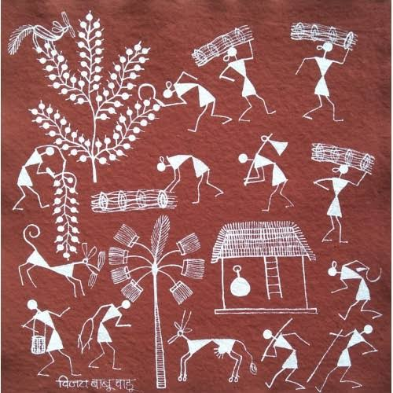
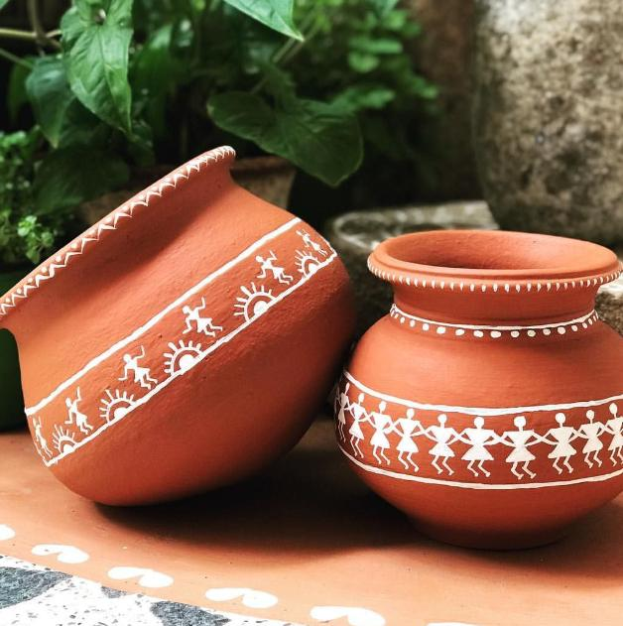
THANK YOU!

